Slide 1
SMART CANTEEN
Food Ordering and Queue Management System
A simple digital solution for ordering food, managing a cart,
and viewing the order queue.
TEAM MEMBERS
• CH. Gireesha — 24KB1A05B8
• P. V. Amarnadh Reddy — 24KB1A05CW
• P. Jahnavi — 24KB1A05DJ
• P. Gowtham — 24KB1A05DK
• M. Komalaya — 24KB1A05X7
PROJECT PRESENTATION

Slide 2
Project Overview
What the Smart Canteen system is designed to do
Smart Canteen is a web-based food ordering interface that lets users browse available food items, add items to a cart, review the total amount, and view an order queue.
Browse menu
View food names, prices, and available stock.
Build an order
Add selected items to the cart and see the total.
Main idea: make canteen ordering clearer and more organized.
Track queue
Use the order queue area to refresh and review orders.
02

Slide 3
Problem Statement
Why a digital canteen ordering system is useful
Long queues
Manual tracking
Limited visibility
Students may spend break time waiting to place an order.
Paper-based orders can be harder to organize during busy periods.
Customers need a clear view of menu prices and stock.
Project objective
• Provide a single screen for the food menu and cart.
• Display item price and available stock before ordering.
• Support a more organized order queue.
03

Slide 4
Objectives
Key goals of the project
01 Display menu
02 Add to cart
03 Calculate total
Show food items with prices and stock quantities.
Allow users to select items for an order.
Present the order amount in rupees.
04 Customer details
05 Order queue
Provide a field to enter the customer's name.
Provide an area to refresh and view queued orders.
04

Slide 5
System and Technologies
High-level view based on the running project interface
Frontend
Local web server
Order data
Web page showing the menu, cart, customer-name field, and order queue.
The application is accessed through a localhost address in a browser.
Menu items include names, prices, and stock values; order queue is part of the interface.
Implementation note
Confirm the exact framework, backend language, and database from your source code before presenting them as final technologies.
05

Slide 6
System Workflow
Typical user journey through the application
1
2
3
4
5
Open website
Choose food
Add to cart
Review order
Submit / queue
Launch the application in a browser.
Check menu, price, and stock.
Select items using the Add to Cart button.
Check cart items and total amount.
Enter customer details and use the order controls.
The exact checkout/queue behavior depends on the implemented backend.
06

Slide 7
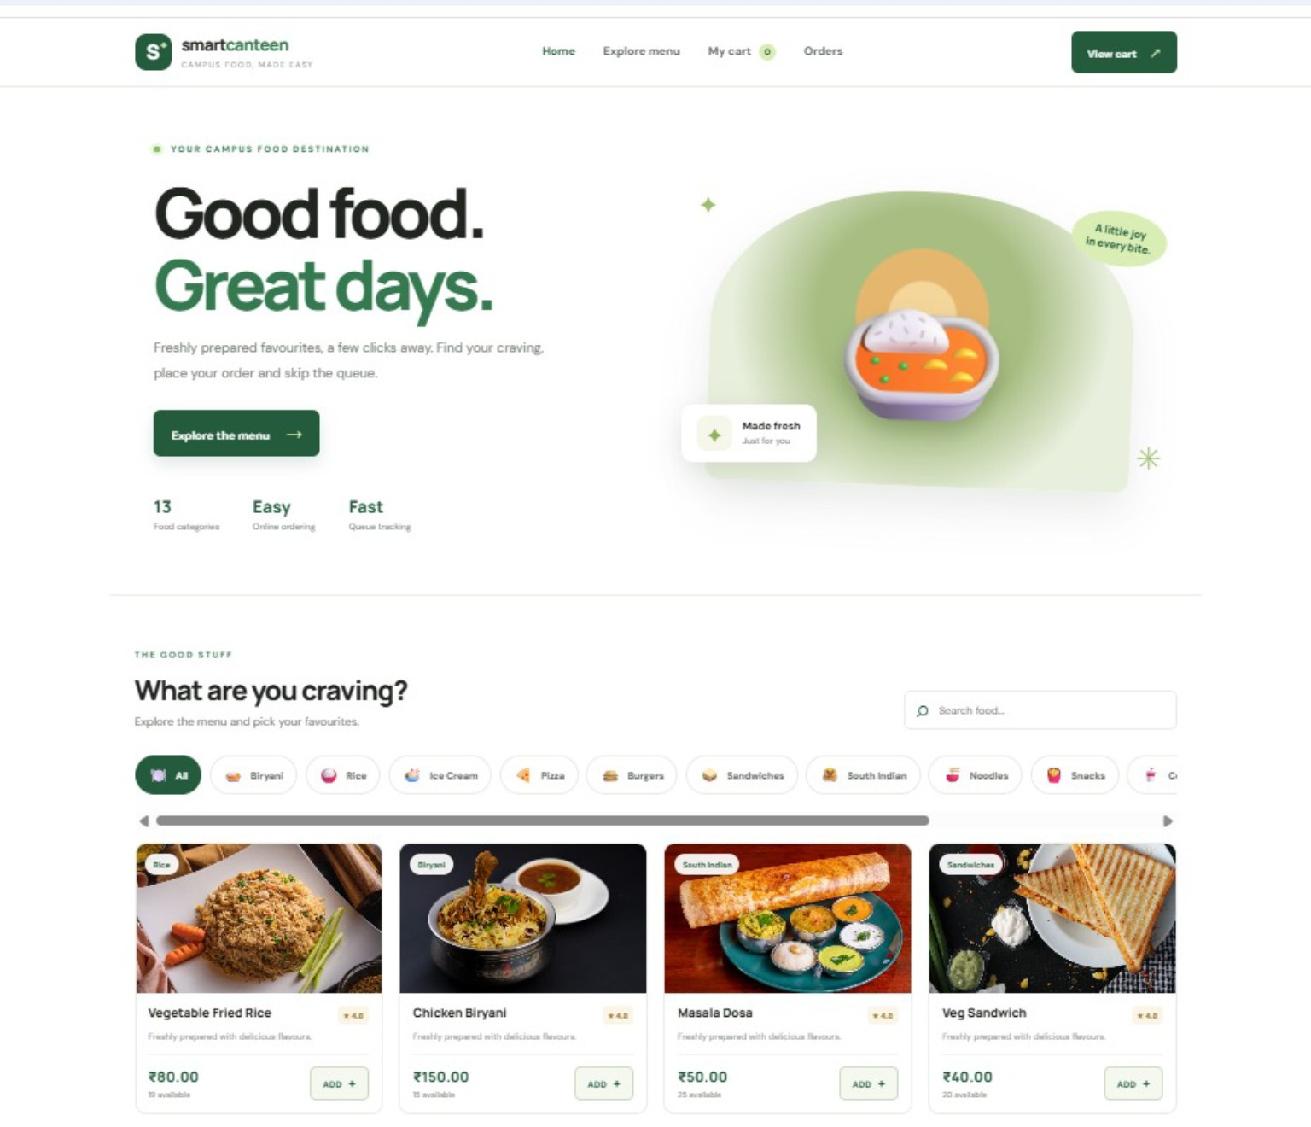
User Interface: Food Menu
The menu lists available items, prices, stock, and an Add to Cart action

Slide 8
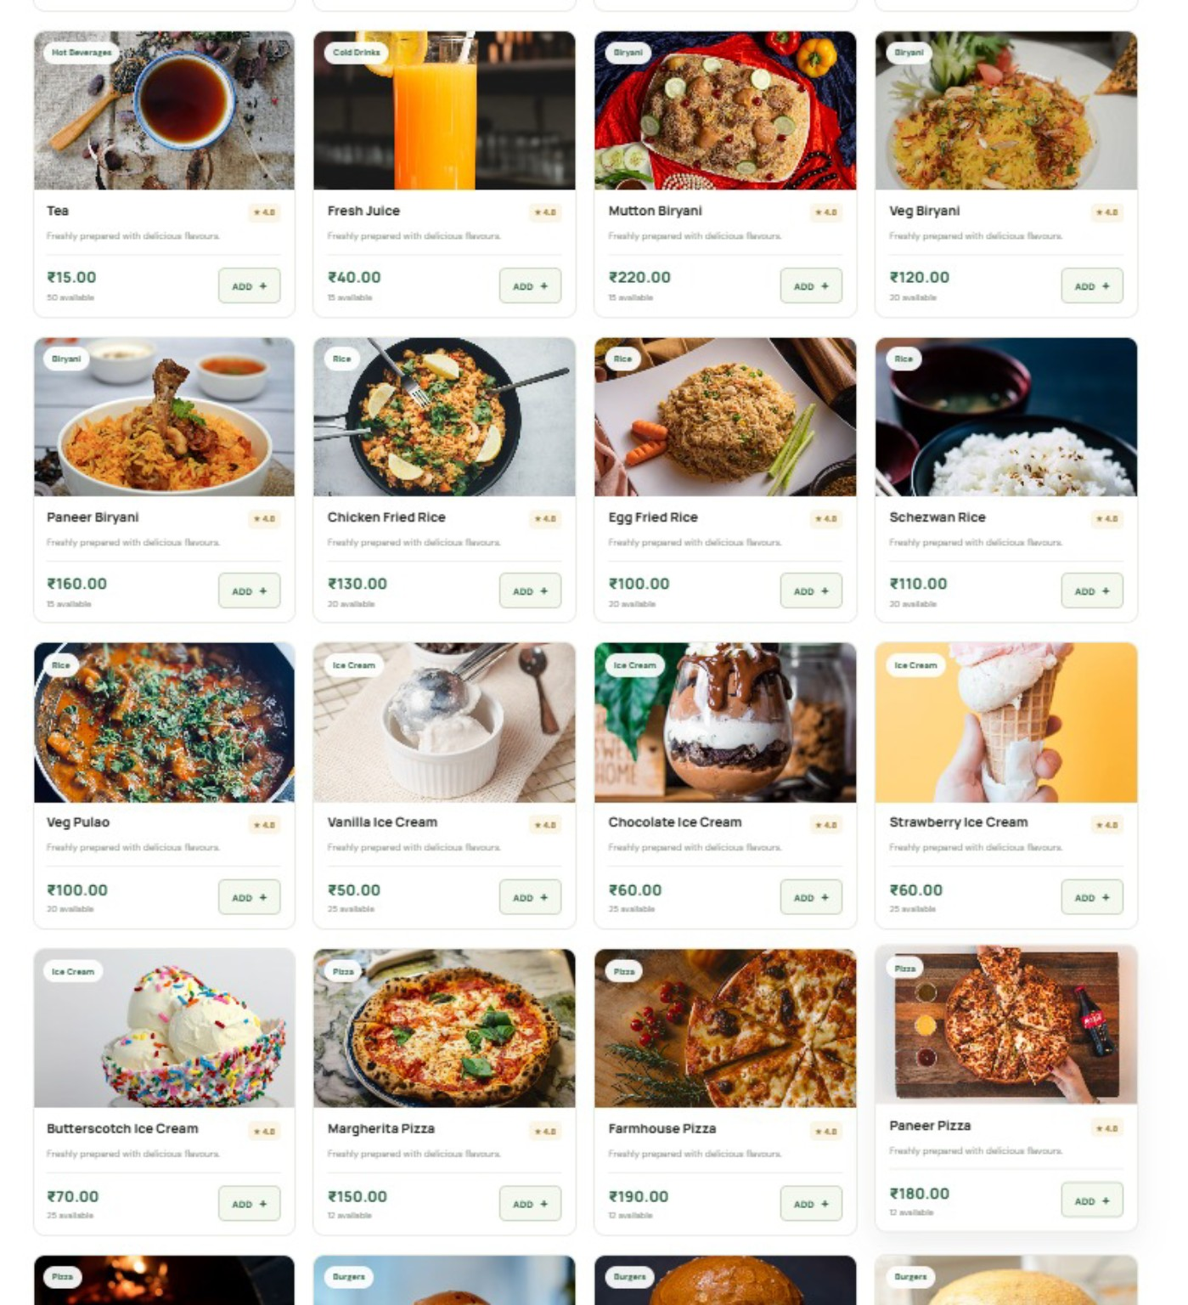
Explore Menu: More Food Options
The menu is arranged in food categories with item photos, descriptions, prices, and stock details.
13

Slide 9
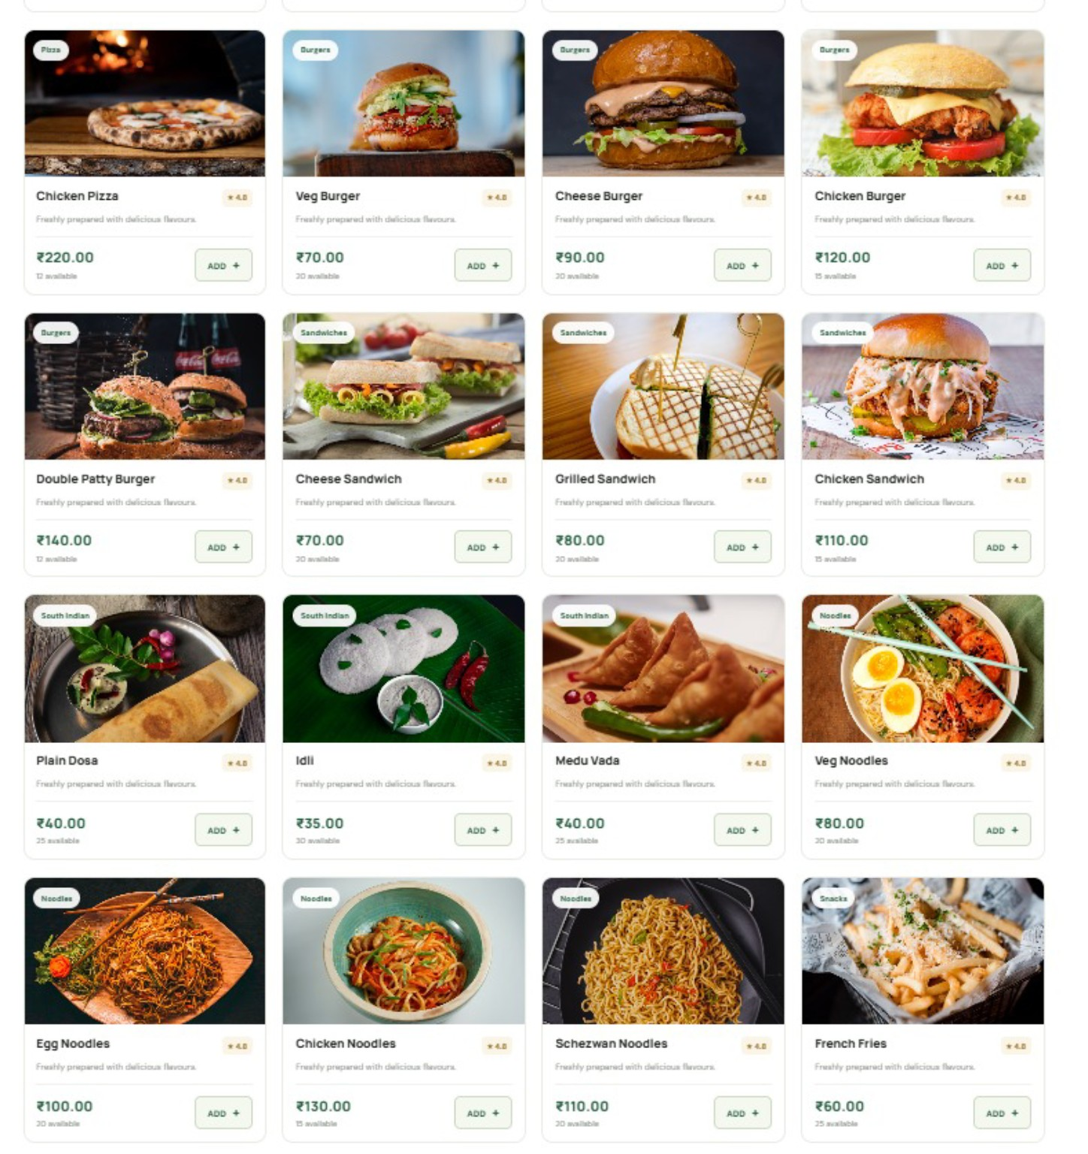
Explore Menu: Burgers, Sandwiches and South Indian
Customers can browse different categories and add their preferred items directly to the cart.
14

Slide 10
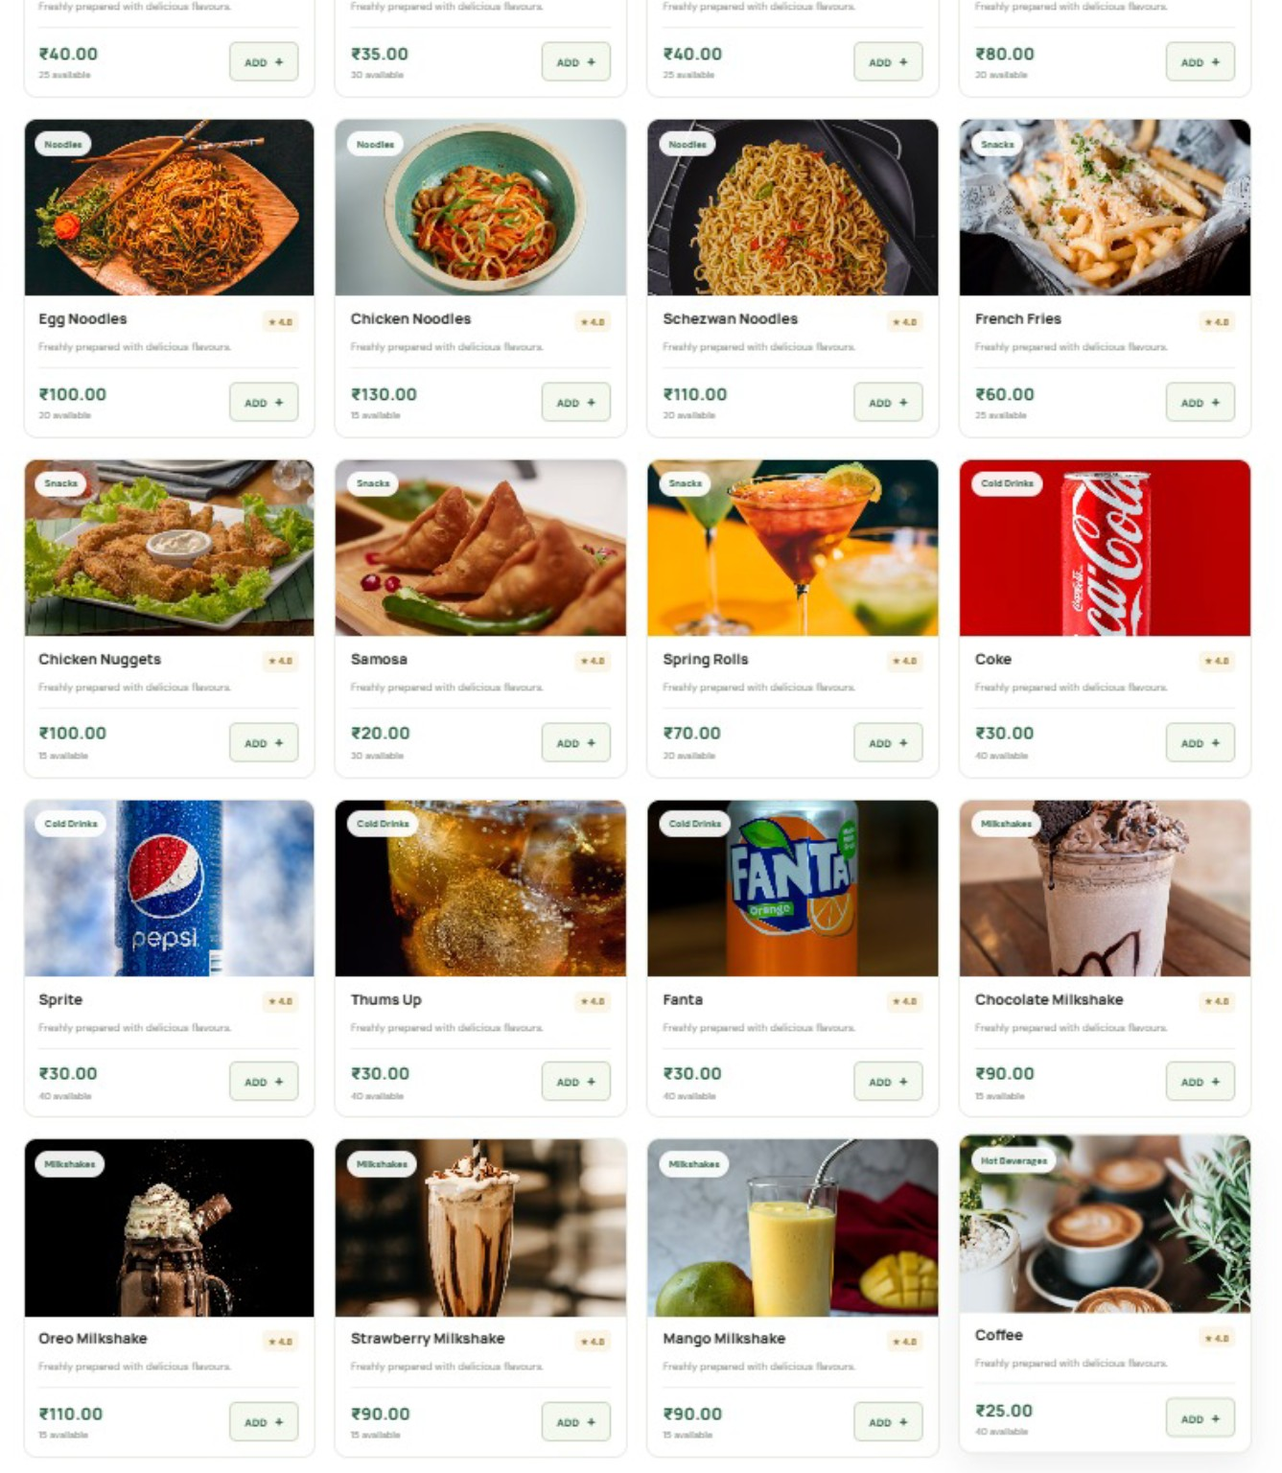
Explore Menu: Snacks and Beverages
The catalogue also includes snacks, cold drinks, milkshakes, and hot beverages.
15

Slide 11
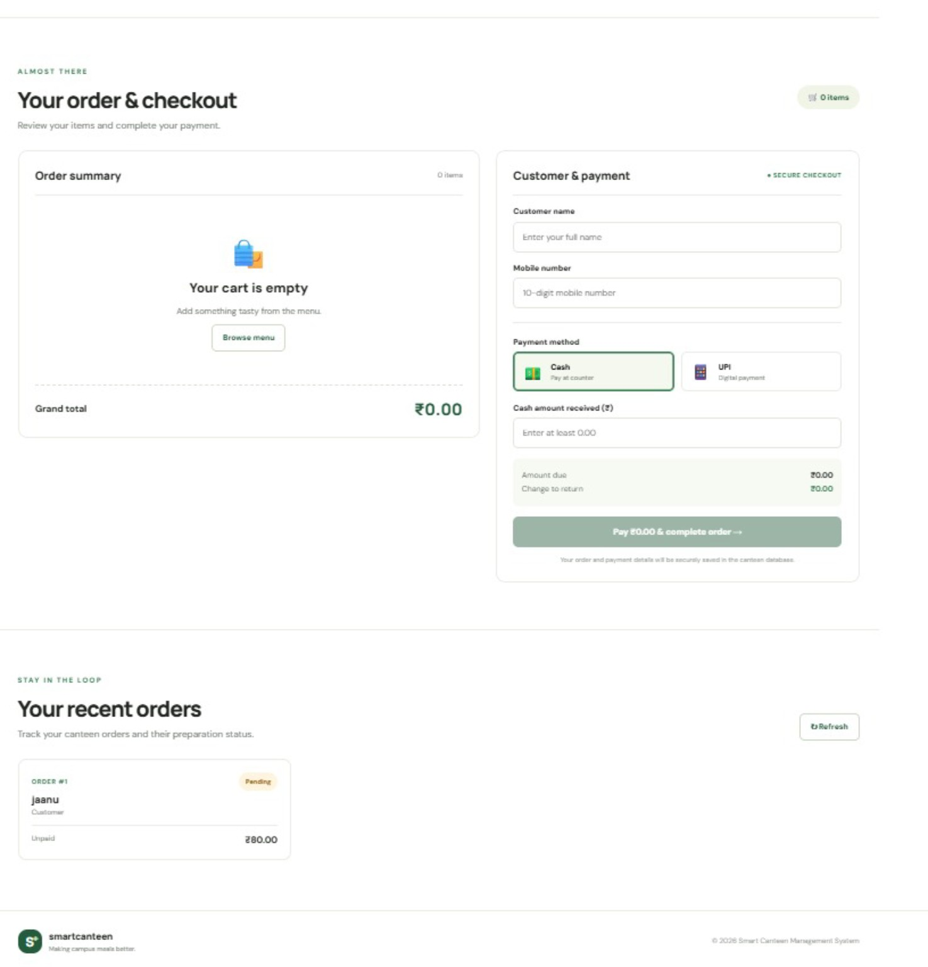
Checkout & Recent Orders
Customer details, payment selection, and order tracking
Customer information
Collects the customer's full name and mobile number.
Payment options
Allows the customer to select Cash or UPI.
Cash calculation
Shows the amount received, amount due, and change to return.
Recent orders
Displays order details, payment status, and the order amount.
Interface screenshot from the Smart Canteen project.

Slide 12
Key Features
Functions visible in the current interface
Menu display
Cart management
Total calculation
Food names, prices, and stock availability.
Add items and review the cart contents.
Show total order amount in ₹.
Customer name
Order queue
Simple UI
Input field for identifying the order.
Refresh control for viewing orders.
One page keeps the main ordering actions together.
09

Slide 13
Benefits
Expected value for students and canteen staff
For students
For canteen staff
Easier menu browsing, clear pricing, and a convenient cart view.
A structured order queue can help organize incoming orders.
For the canteen
For future development
Digital ordering can reduce confusion during busy breaks.
The system can be extended with payment, login, and notifications.
10

Slide 14
Future Enhancements
Possible improvements after the current prototype
• Add user login and role-based access for customers and staff.
• Connect a persistent database for menu, stock, and order history.
• Add order status updates such as Pending, Preparing, and Ready.
• Integrate secure online payment or digital payment confirmation.
• Improve the food cards with real food photos and responsive mobile design.
• Add validation, error messages, and automated tests.
11

Slide 15
CONCLUSION
Smart Canteen brings the main food-ordering steps into one web interface: browse the menu, select food, review the total, and access the order queue.
Thank You
Questions?

